Slide 1

Hotel Mangement System
Shivangi Dubey Neha Kujur Ayush Kumar Jagrat Patel

Slide 2

Introduction
The Hotel Booking System (HBS) is a C++-based software designed to streamline hotel operations using object-oriented principles. It automates tasks like bookings, guest management, billing, and room allocation, enhancing efficiency and accuracy. With features like error handling and a user-friendly interface, HBS modernizes hospitality management while reducing staff workload and errors.

Slide 3
Abstract
Streamlined Reservation Process: The system enables customers to choose room types, specify guest details, and book multiple rooms for varying durations, enhancing convenience and operational efficiency.
Secure Data Management: It collects and manages personal information like phone numbers, IDs, and addresses, ensuring accurate records and data security.
User-Friendly Interface: The intuitive design reduces errors, minimizes manual effort for staff, and provides personalized customer offers for frequent guests.
Scalable and Modern Solution: Leveraging advanced programming and database techniques, the system delivers a reliable, adaptable solution for hotels of all sizes, boosting customer satisfaction and operational reliability.

Slide 4

Project Specification
Application Area : Hotel End user : Customer

Slide 5
Data Dictionary
DATA DICTIONARY:
Class : CustomerInfo Room DeluxeRoom Customer Hotel
Member Functions : calculateBill(), displayRoomInfo(), Room(), displayRoomInfo(), addPoints(),
setBookingDate(), displayCustomerInfo(), checkOffers(), displayAllRooms(), bookRoom(),
checkCustomerOffersById()

Slide 6
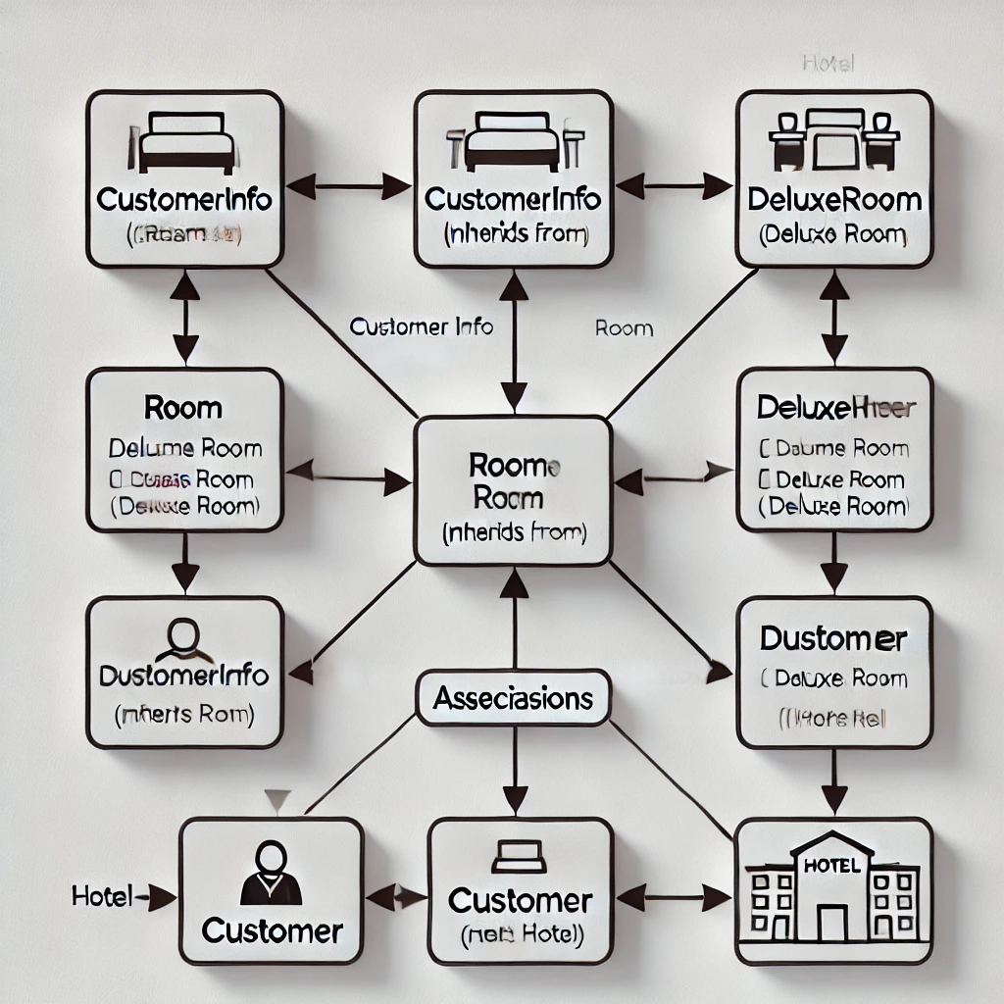


Slide 7
MENU CHOICES AND ACTIONS:
Display all rooms
Book a room
Display all customers
Check offers for a customer by ID
Exit

Slide 8
Hotel Booking System Workflow
1. Room Booking Process:
Prompt user for room type, number of guests, and calculate rooms needed.
Collect additional details: number of nights, contact info, and guest names.
Call hotel.bookRoom() to finalize booking.
2. Display Customer Details:
Use hotel.displayAllCustomers() to view all current bookings.
3. Check Customer Offers:
Prompt for customer ID and display offers using hotel.checkCustomerOffersById().
4. Exit Option:
Exit the program with an appropriate message when selected.
5. Error Handling:
Display error messages for invalid inputs and prompt the user to retry.

Slide 9
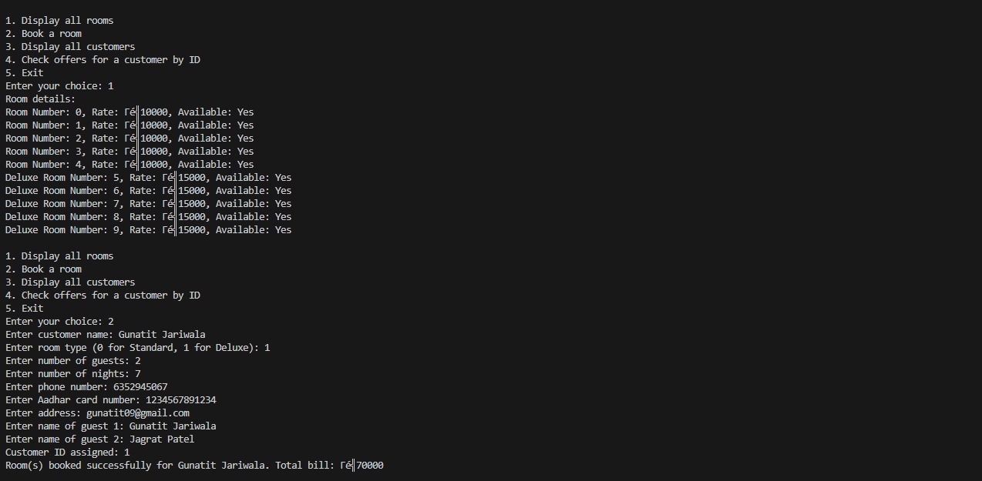
Output
Output

Slide 10
Thank You

